Slide 1
IT solution and services for Green Plant Market
Yaroslav Holota

Slide 2

Automation of business processes results in increase in their productivity, as such performing this operation in an efficient and predictable fashion is crucial. That is the goal of the work.
Yaroslav Holota (yaroslavholota@gmail.com)

Slide 3

Consumer
Find plants for sale
Read instructions
Order plants
Producer
Keep plants stock
Sell plants
Deliver plants
Create instructions
Manager
Data analysis
User management
View historical data
Yaroslav Holota (yaroslavholota@gmail.com)

Slide 4
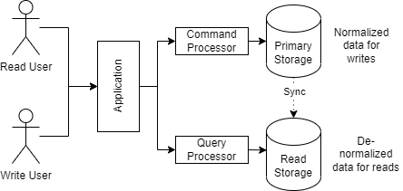
CQRS
Conventional design uses the same model for read and write operations. This may not be a sufficient “compromise”.
CQRS concepts resolves this by unbinding the read and write models.
Yaroslav Holota (yaroslavholota@gmail.com)

Slide 5
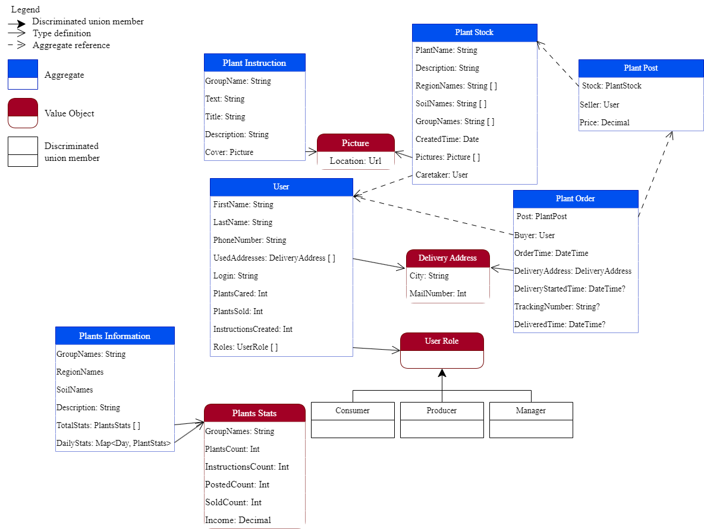
DDD domain modeling

Slide 6
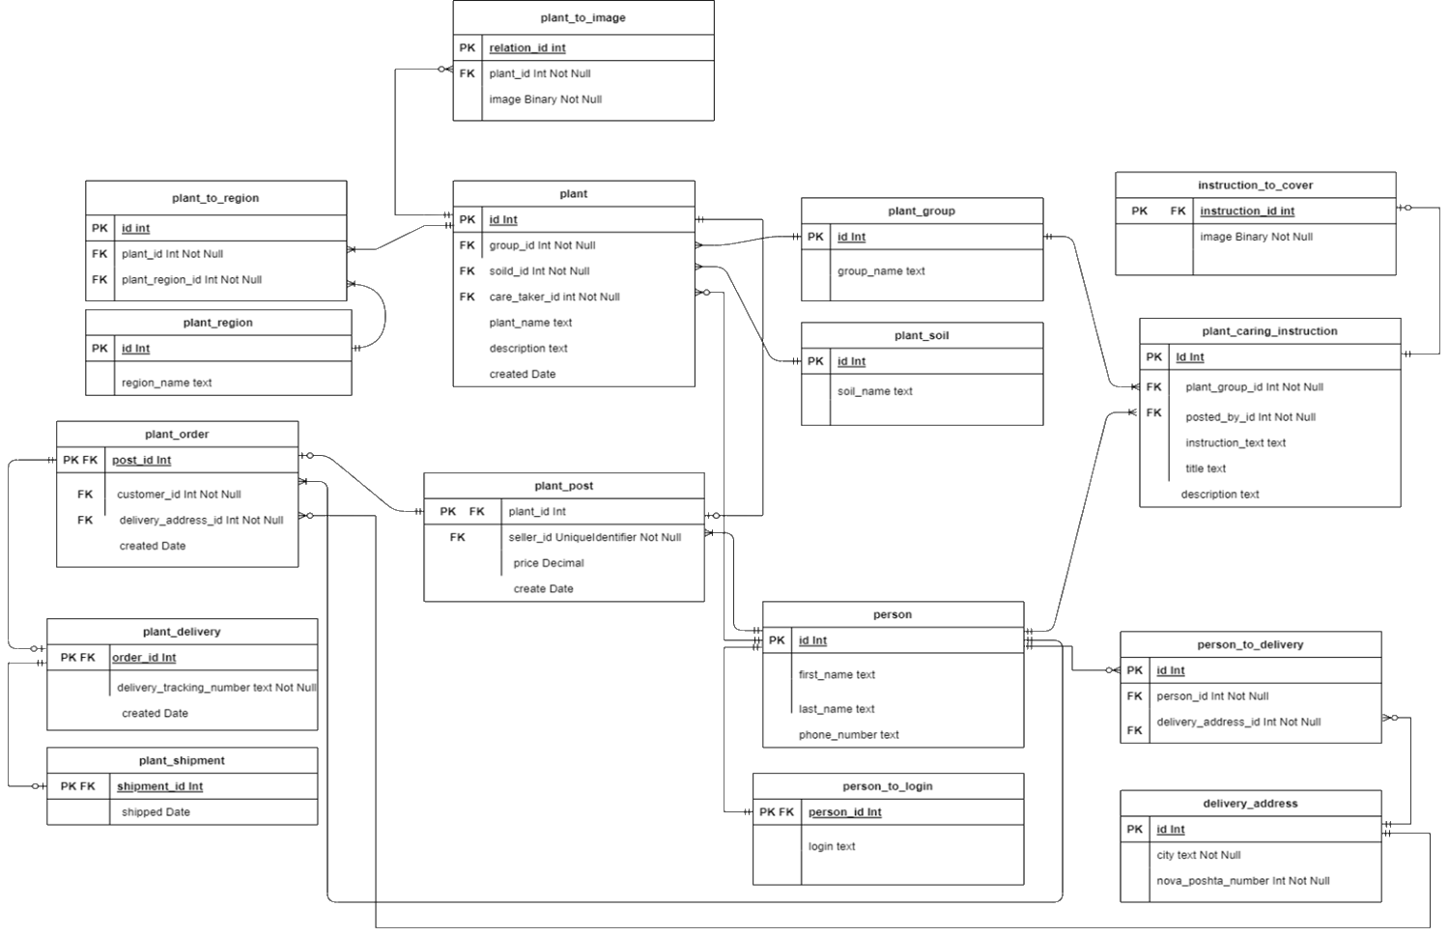
Domain modeling comparison

Slide 7
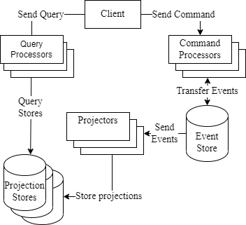
Event Sourcing
Events Sourcing provides a resilient model for performing the process of syncing the “read model” and “write model”.
Additionally, using this model allows us to parallelize the work and slice the areas of responsibility.
Yaroslav Holota (yaroslavholota@gmail.com)

Slide 8
Thank you!
Yaroslav Holota (yaroslavholota@gmail.com)

